Slide 1
Pre-process
Use all 12 images in a set
Supersampling
Crop according to bounding box
Segmentation
Sharpening
CLAHE (Contrast Limited Adaptive Histogram Equalization)
Change feature point detection algorithm (SIFT, Akaze)
Adjust parameters

Slide 2
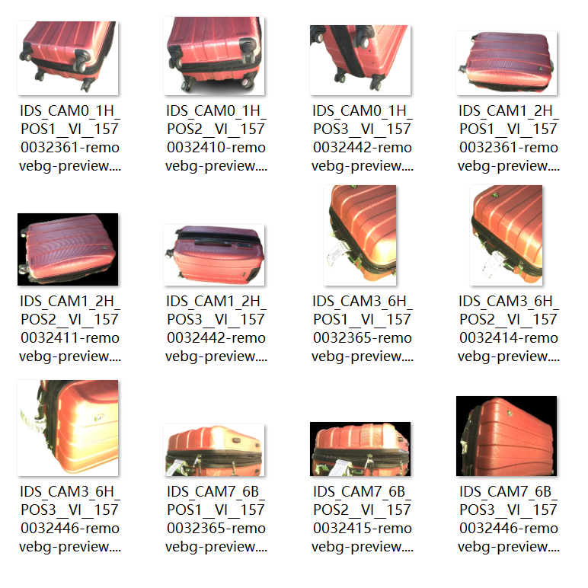
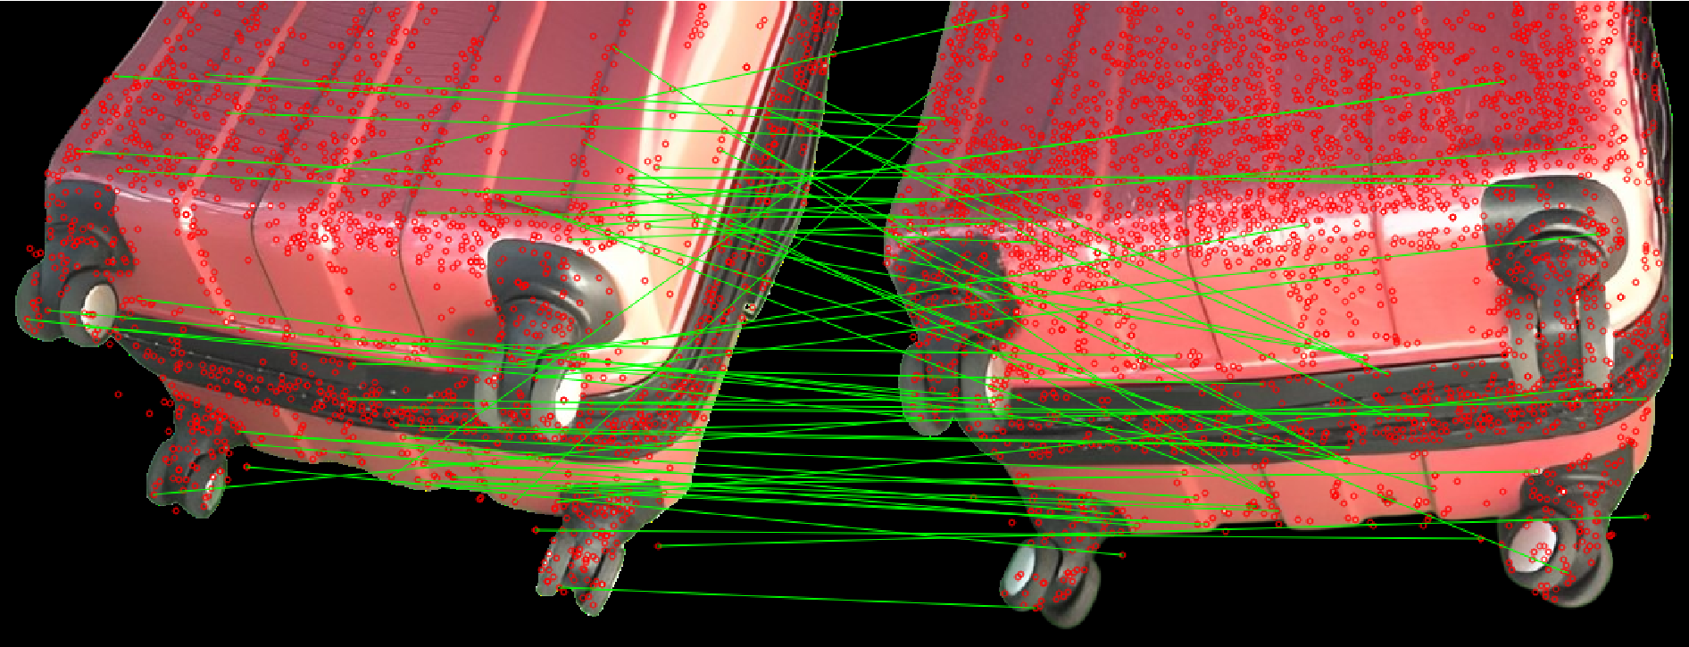
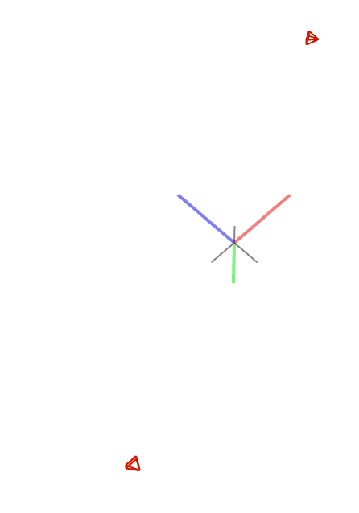
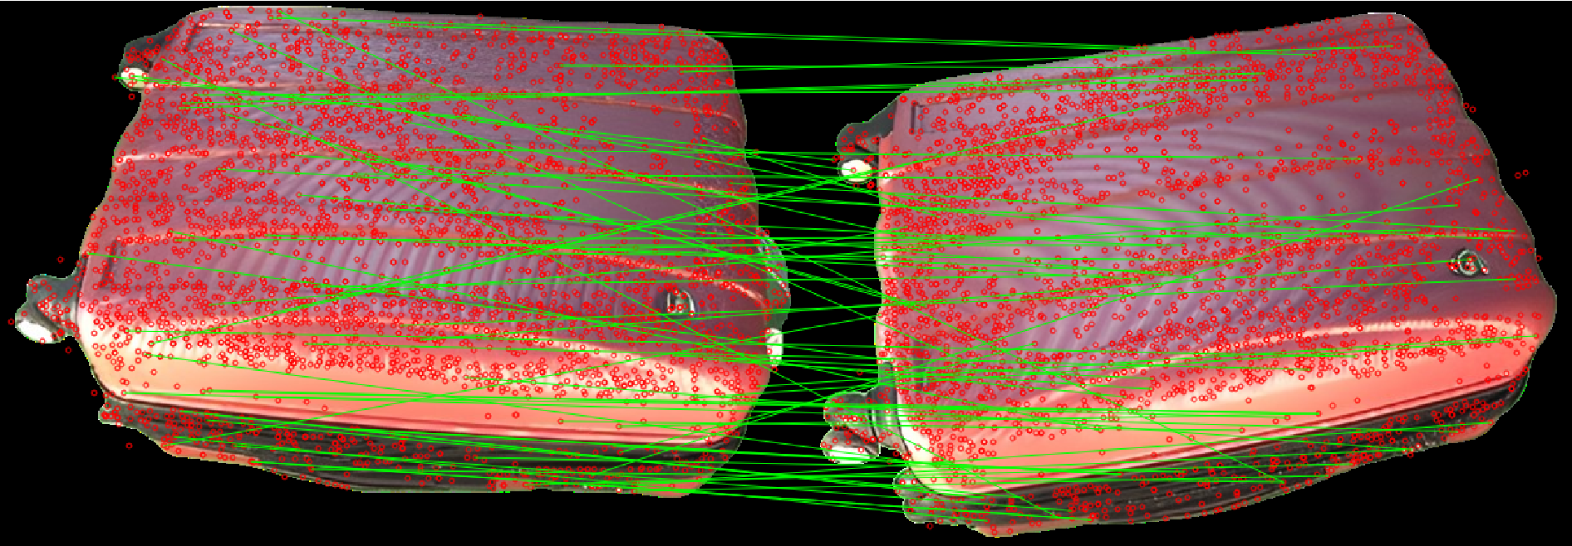
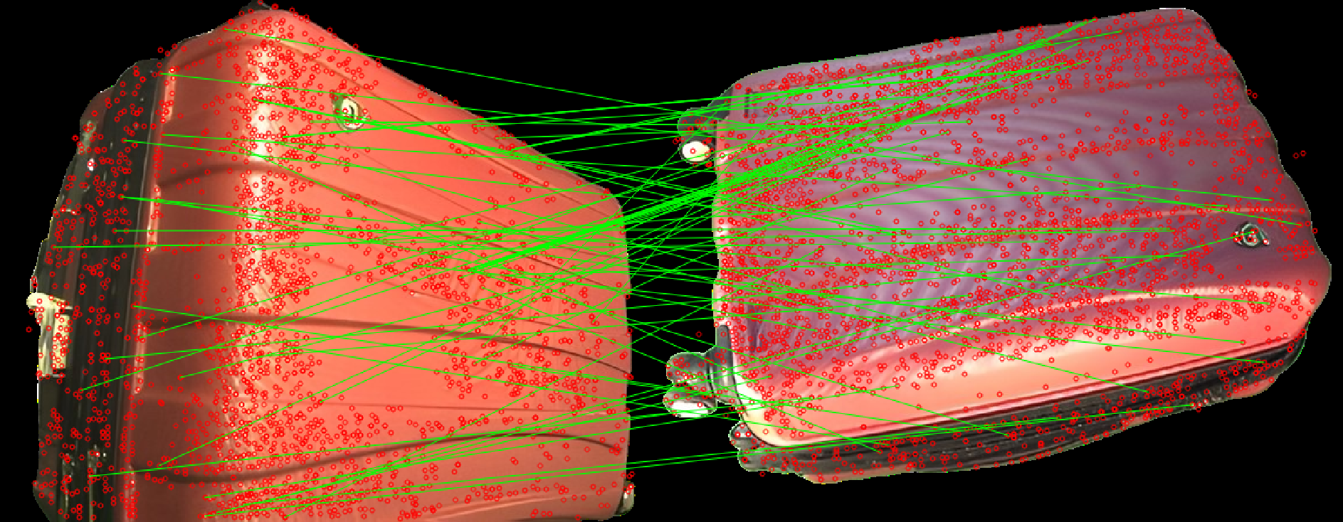
Colmap

Slide 3
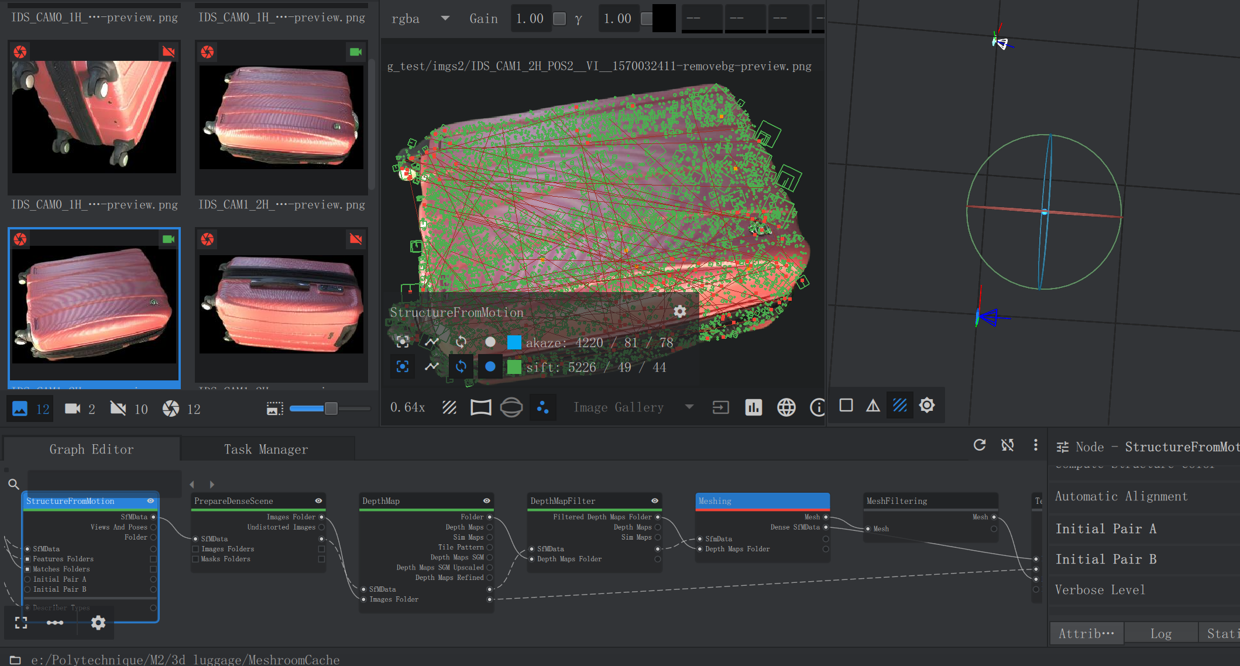
Meshroom
Only a few camera are reconstructed

Slide 4
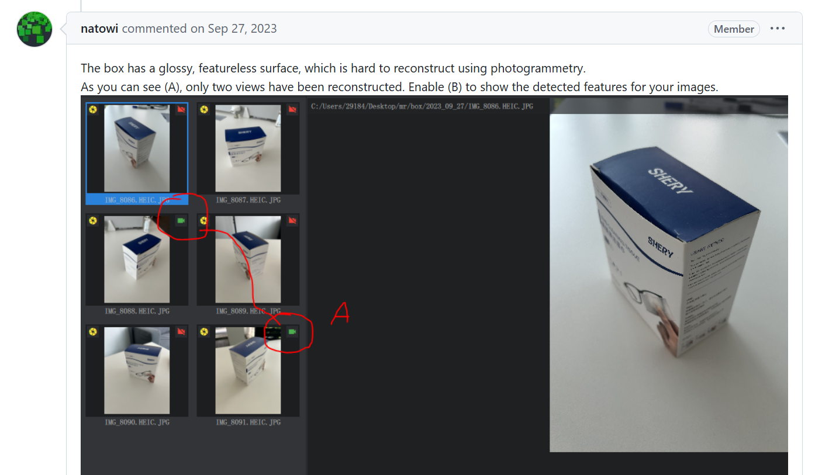
Meshroom
Similar
situation

